Slide 2
72% of all
tourists
travelled
alone
in 2019
Source : Klook’s 2019 travel trends report

Slide 4
Micro-Community

Slide 5
Travel alone

Slide 6
But experience together

Slide 7


Slide 9


Slide 11
An individual who travels alone

Slide 12
An individual who travels alone
Feels alone

Slide 13
A product for travellers to meet other travellers

Slide 14
An experience

Slide 15


Slide 16
The problem?

Slide 17
Lack of Interactivity

Slide 18
Abundance of awkwardness

Slide 20
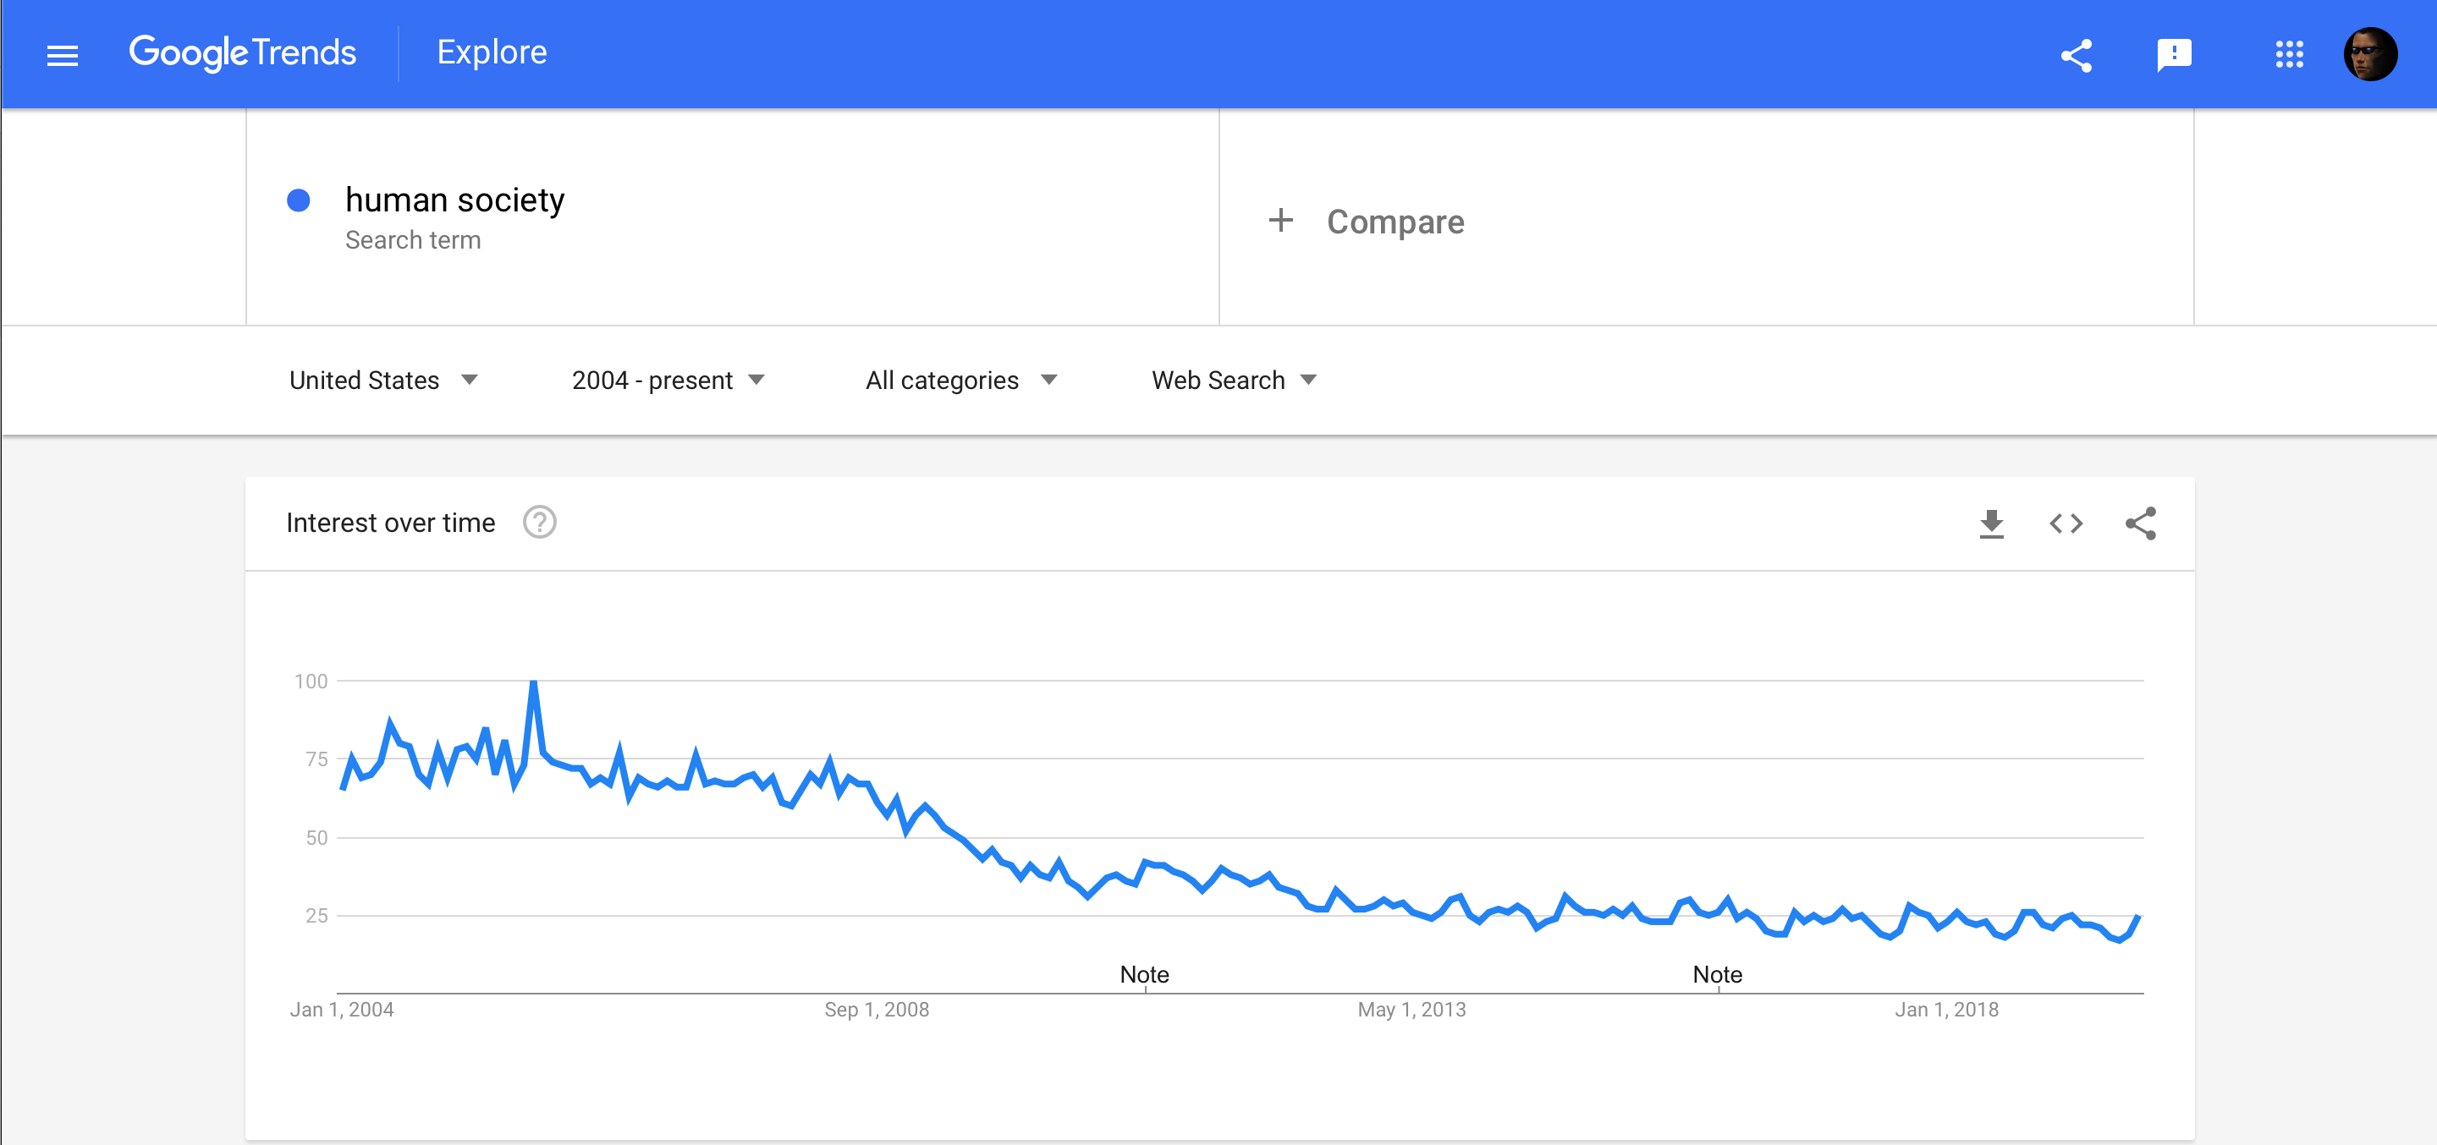


Slide 21
Our solution?

Slide 22




Slide 23



Slide 24


Slide 25
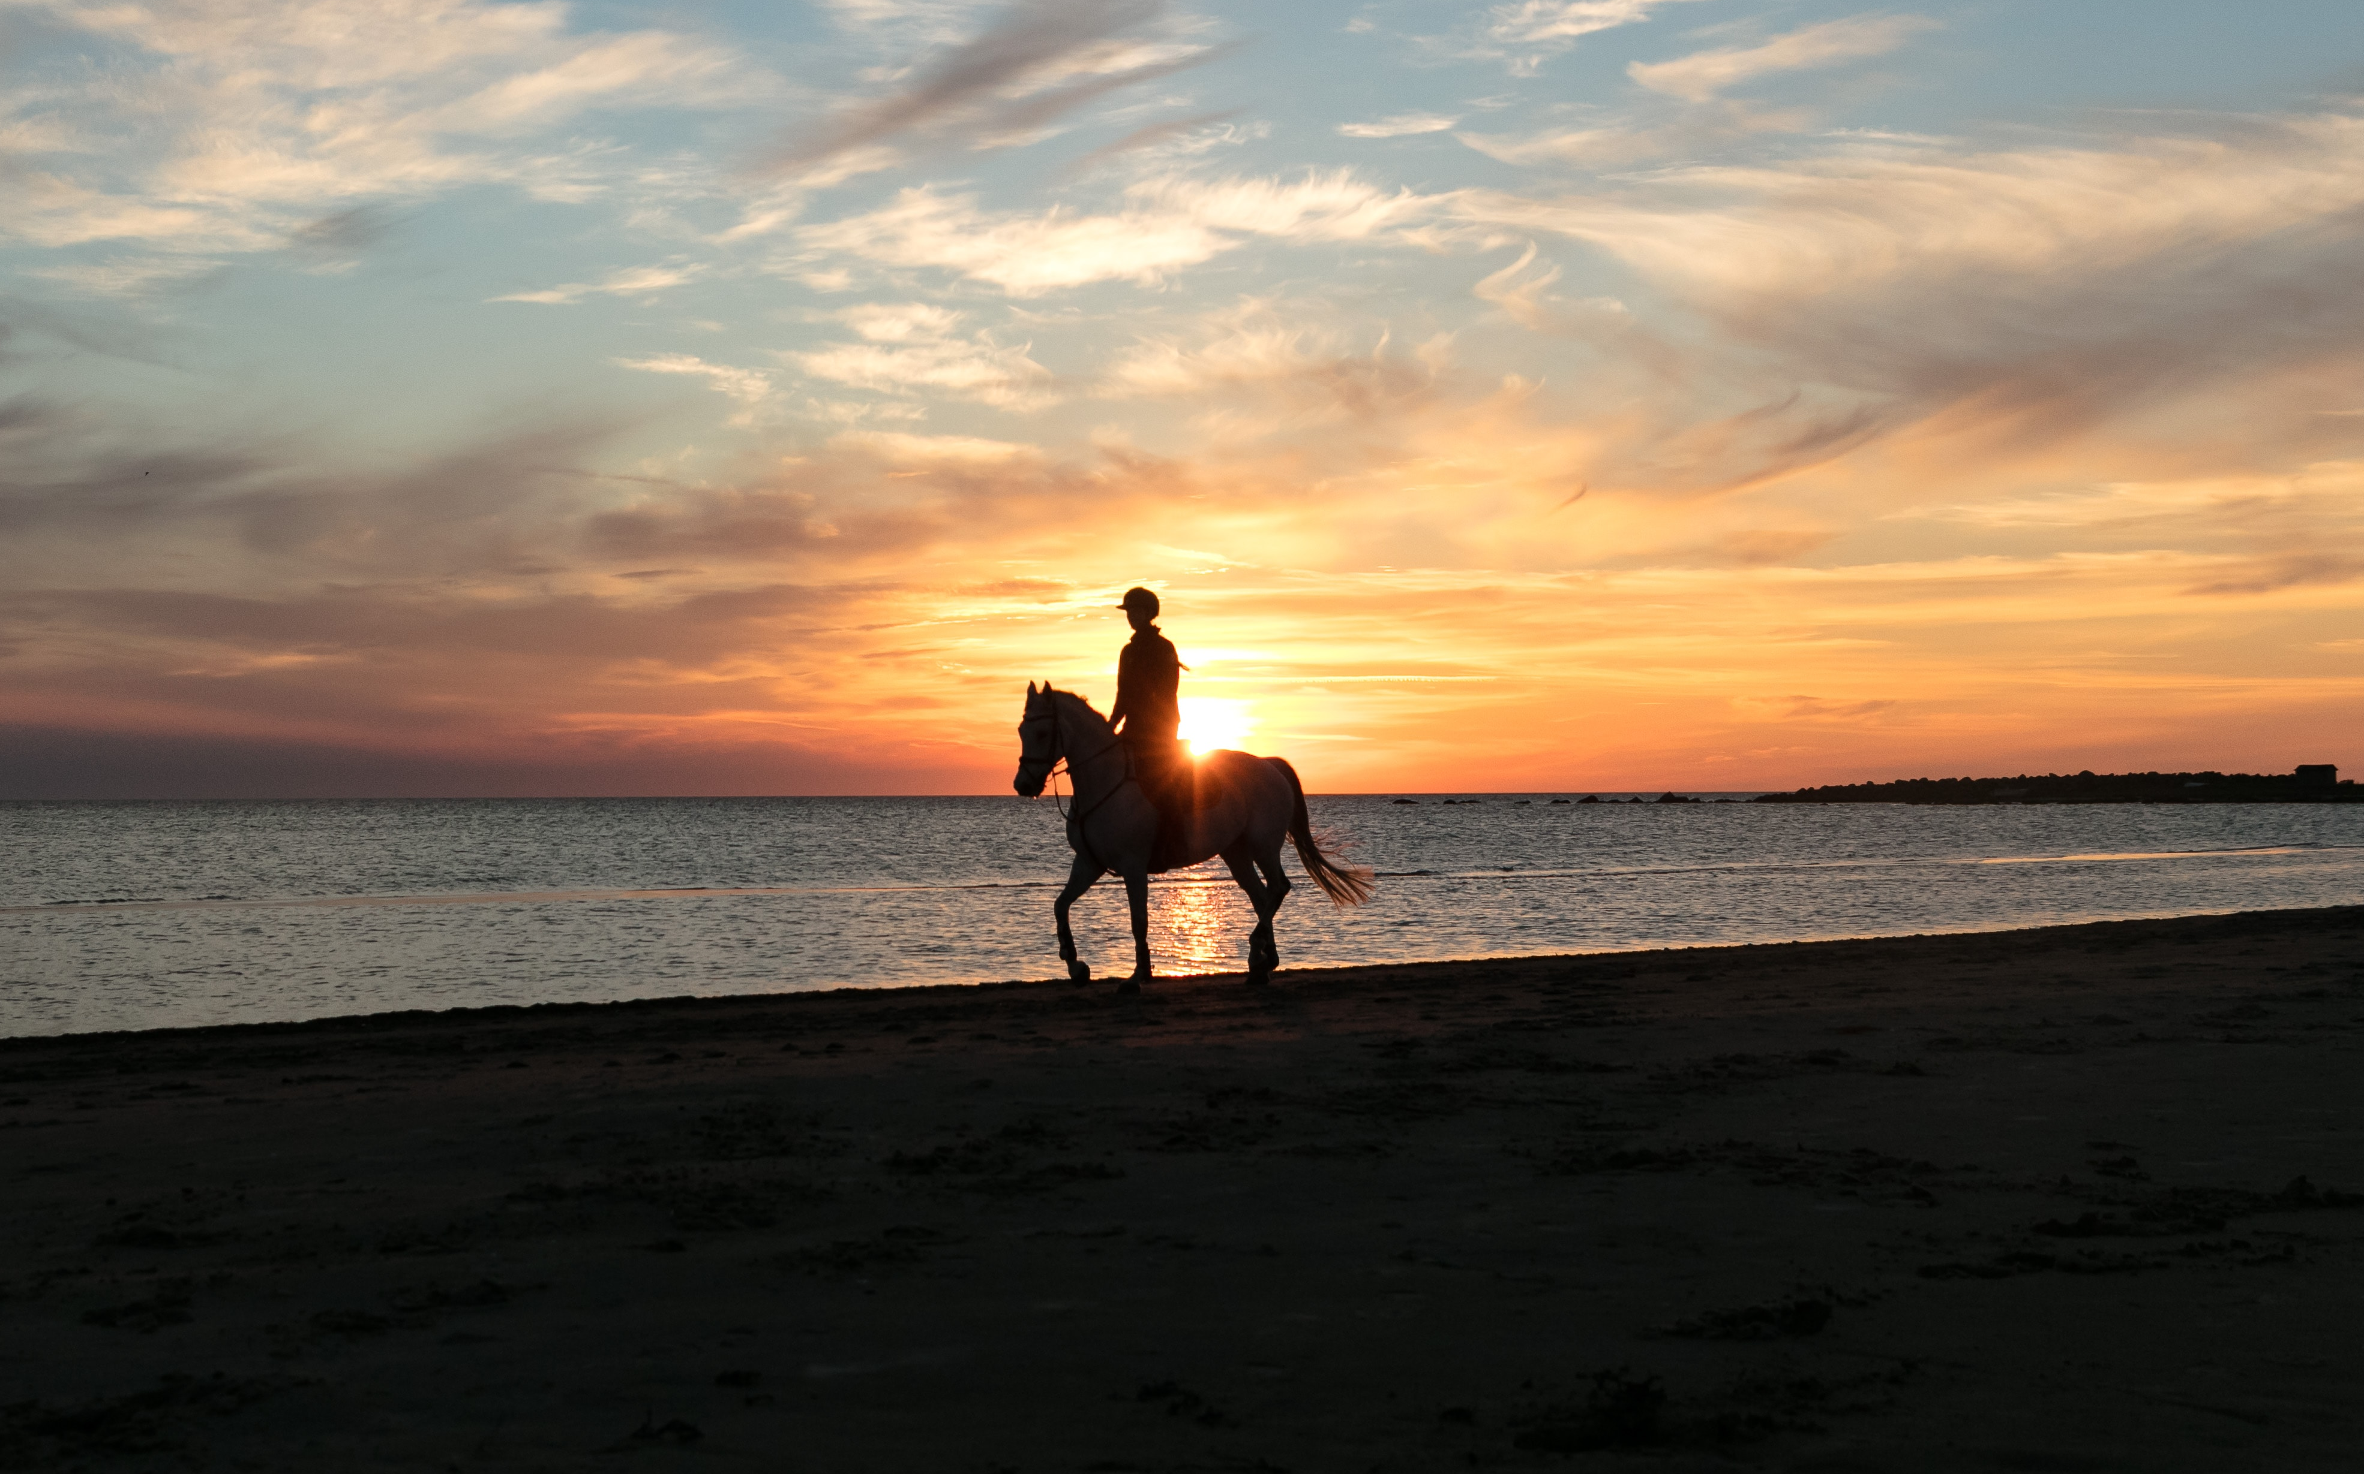

Slide 26


Slide 27
Product Demo

Slide 29
Development Stacks
For V1, we used Flask + React to develop the app
For V2, we used Ruby on Rails to develop it, once we discovered it’s potentially for scalability

Slide 30
Challenges
Our primary challenge involved in us developing a chat system for the application.
We used open source tools like sockets.io, but the implementation was still fairly complicated

Slide 31
But we did it!

Slide 32
Future

Slide 33
Additional forms of interactivity

Slide 35
Integration for easy payment sharing

